Slide 1





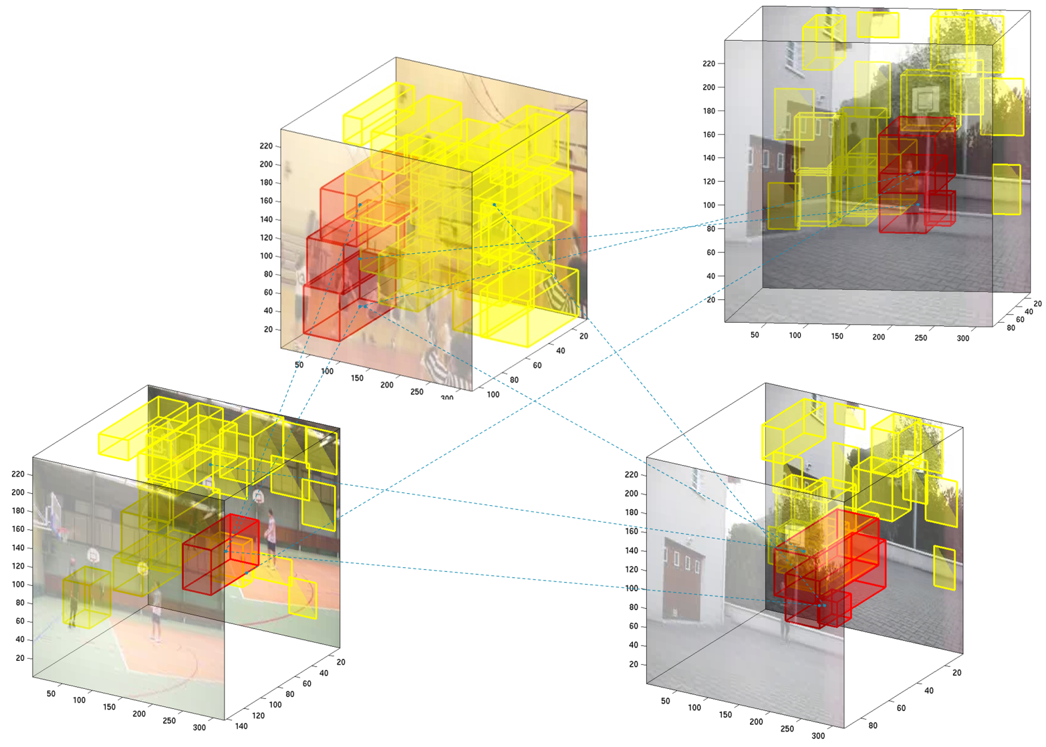
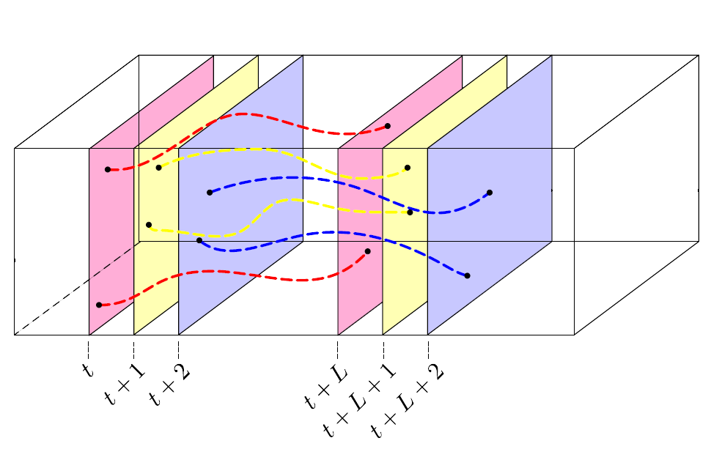
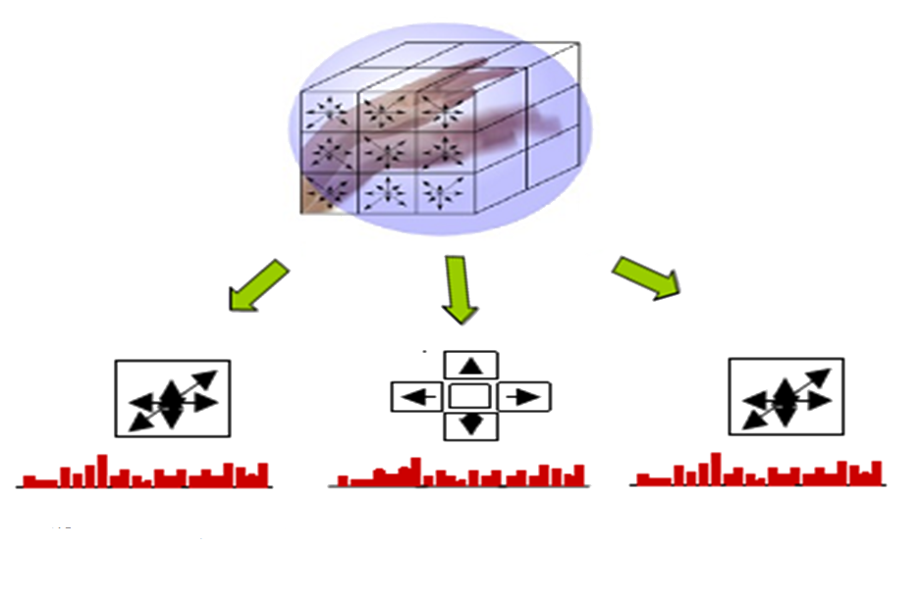
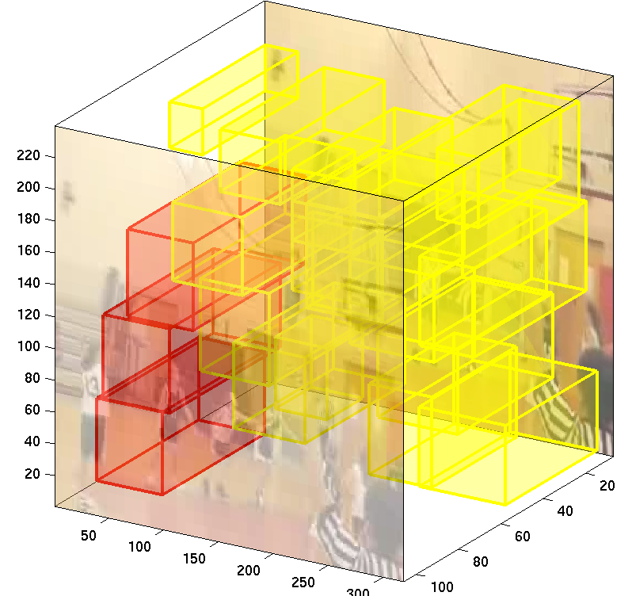
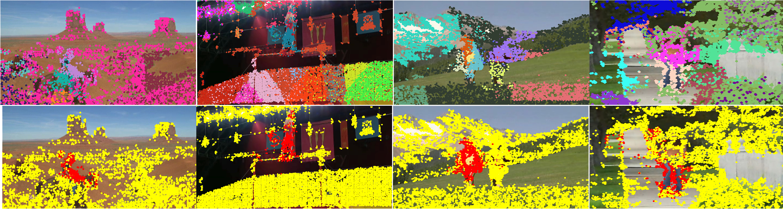
Coupling Video Segmentation and Action Recognition
IEEE 2014 Winter conference on Applications of Computer Vision
Amir Ghodrati, Marco Pedersoli, Tinne Tuytelaars
Abstract
Whether and how motion segmentation can be exploited for action recognition.
For both tasks, state-of-the-art methods are built on the same set of low level features, known as trajectories.
We propose and evaluate several ways to integrate and combine these two tasks:
Co-segmentation
Experimental results
Take into account similar motion and appearance characteristics that a trajectory-group shares with trajectory-groups among other videos of the same label.
Graph G
Nodes: all trajectory-groups of all training videos of class c.
Edges: connecting the k most similar nodes
YouTube
11 categories, 1600 videos
UCF Sports
10 categories, 150 videos
Method (UCF_Sports) | accuracy
Lan et al. [5] | 73.1%
Raptis et al. [7] | 79.4%
Shapovalova et al. [3] | 75.3%
Todorovic et al. [6] | 86.8%
Iterative (1) Kernel (2) (1)+(2) | 81.5% 86.1% 86.1%
Method (YouTube) | Rec. accuracy
Ground-truth bounding box (upper bound) | 88.5%
No seg. + linear | 83.5%
Bottom Up + linear | 83.6%
Actionness + linear | 85.0 %
Actionness + kernel | 86.2%
Act. + Co-seg. + linear | 85.1%
Act. + Co-seg + kernel | 86.8%
Segmentation
Co-segmentation
Iterative learning
Kernels
Trajectories
Trajectory-group i
Binary label of trajectory-group i
From [8]
description
Unary cost
Balancing factor
Similarity function
Method (YouTube) | accuracy
Brendelet al. [1] | 77.8%
Wang et al. [8] | 84.2%
Sapienza et al. [4] | 80.0%
Gaidon et al. [2] | 87.9%
Iterative (1) Kernel (2) (1)+(2) | 86.7% 86.8% 87.4%
HOG
HOF
MBH
General Recognition Pipeline
Iterative Learning
foreground
Bow description
_{Hf}
We believe that segmentation and recognition can help each other.
Latent-SVM based approach
The objective is not better segmentation but better classification.
Latent variables are foreground/background labels of each trajectory-group.
Two major restrictions of L-SVM
sensitive to initialization
works with linear models
Initial Seg. | Method (YouTube) | Rec. accuracy
Random | Iter. + Act. + Co-seg | 85.7%
Act. | Iter. + Act.+ Co-seg | 86.7%
GT | Iter. + Act.+ Co-seg | 86.7%
first video
Segmentation Algorithm
background
Bow description
_{Hb}
.
.
.
nth video
Segmentation Algorithm
foreground
Bow description
_{Hf}
Learning action models
background
Bow description
_{Hb}
Conclusion
A good video segmentation is fundamental to obtain accurate action recognition.
Coupling segmentation and recognition in an iterative learning can always improve the recognition accuracy.
An alternative way to obtain similar results is to map the features into a non-linear kernel.
Segmentation
Initial over-segmentation of the video in trajectory-groups.
Actionness (Θ): Learning the similarities that trajectory-groups share across the DATASET, independent of the action label.
Cost of discriminative learning
Discriminative model
Kernels
References
[1] Brendelet al., Activities as time series of human postures, ECCV, 2010
[2] Gaidon et al., A time series kernel for action recognition, BMVC, 2011.
[3] Shapovalova et al., Similarity constrained latent support vector machine, ECCV, 2012.
[4] Sapienza et al., Learning discriminative space-time actions from weakly labeled videos., BMVC, 2012.
[5] Lan et al. , Discriminative figure-centric models for joint action localization, ICCV, 2011.
[6] Todorovic et al. , Human activities as stochastic kronecker graphs, ECCV, 2012.
[7] Raptis et al., Discovering discriminative action parts from mid-level video representations, CVPR, 2012.
[8] Wang et al., Action recognition by dense trajectories, CVPR, 2011.
While the iterative learning is a powerful tool, it is limited to linear model
An alternative way is to map the features into a kernel.
Excluding the iterative learning, all the other proposed methods can be used together with a kernel
Foreground/Background histogram of video
Chi-square distance

